Slide 1
PROJECT TITLE: “VEHICLE PARKING MANAGEMENT SYSTEM”
PIP104 PROFESSIONAL PRACTICE-II
VIVA-VOCE
Batch Number: CSE-G161
Under the Supervision of,
Ms. AYESHA TARANUM
Assistant Professor
School of Computer Science Engineering & Information Science
Presidency University
Roll Number | Student Name
20201CSE0824 | KHUSHI
20201CSE0795 | PALLAVI HP
20201CSE0840 | CHETHANAA V

Slide 2
Introduction
Vehicle parking management systems (VPMS) are designed to optimize parking space utilization, improve traffic flow, and enhance the overall parking experience for drivers.
The demand for parking in urban areas has far exceeded the available supply, leading to congestion, frustration for drivers, and lost time.
VPMS can also provide personalized parking recommendations, enable dynamic pricing, and facilitate revenue generation through parking fees.
Traditional parking management methods, such as physical signage and manual parking attendants, are often inefficient and unable to keep up with the growing demand
VPMS offer a more sophisticated and scalable solution to address the challenges of parking management.

Slide 3
Literature Review
i. PAPER TITLE: “Smart Parking: Current Trends and Future Challenges”
METHOD: The method used in this literature survey was to conduct a comprehensive review of the literature on the topic of smart parking. The review included articles, books, and reports published in a variety of sources.
ii. PAPER TITLE: “A Review of Intelligent Parking Systems”
METHOD: The method used in this literature survey was to search for articles that discussed the topic of intelligent parking systems in the ACM Digital Library database. The search terms used were "intelligent parking system", "limitations", and "advantages". The articles found were then reviewed to find the most relevant information.

Slide 4
iii. PAPER TITLE: “Parking system based on image processing” METHOD: A unique identification number is required and for this number plates can be a useful identification by identifying and capturing with the help of number plates. This method can be useful to manage the parking area and same can be used for payments. iv. PAPER TITLE: “Automated parking system with Bluetooth access” METHOD : This system requires a Bluetooth device. This device will find the vacant slot in parking. And within the range of Bluetooth device whatever the information would collect it will be transfer to the user. v. PAPER TITLE: “Car park management, with networked wireless sensors and active RFID” METHOD: This system uses networked wireless sensors to monitor the cars in the parking area. For the unique identification of cars, every car must have an RFID tag which would be embedded in it.

Slide 5
Research Gaps Identified
Research Gaps refers to the area or aspects within the existing systems related to parking management where the current understanding, solutions or technologies are incomplete, insufficient or outdated.
Here are some examples of research gaps in context of a Vehicle Parking Management Systems:
Technology Integration
User-Centric Design
Security measures
Data Analytics and Reporting
Integration with Emerging Trends
Adaptability and Scalability

Slide 6
Proposed Methodology
The methodology section of a project outlines the systematic approach and processes used to design, develop and implement the proposed solution. In the context of Vehicle Parking Management System, a comprehensive methodology is essential for ensuring for the successful creation of a robust and effective system. Here is an overview of the methodology, with a focus on the system architecture aspect.
The methodology or the System Architecture proposed in Vehicle Parking Management System will mainly consists of Three main modules:
1.Parking Spaces Module: is responsible for managing and tracking the status of parking spaces with facility.
Status Tracking: Monitors and updates the status of each parking space (occupied or available) in real-time to provide accurate information to users and administrators.
2.Vehicle Modules: Stores and manages information related to vehicles, including license plates and vehicle plates.
Vehicle Information Storage: Stores details about vehicles, including license plates and vehicle types, facilitating efficient identification and management.
User Authentication: Implements a secure user authentication system to ensure that only authorized users can access and modify vehicle information.
3.Parking Records Module: Records and stores data regarding entry and exit of vehicles.
Entry and Exit Logging: Records entry and exit times of vehicles, linking them to specific parking spaces for accurate tracking.

Slide 7
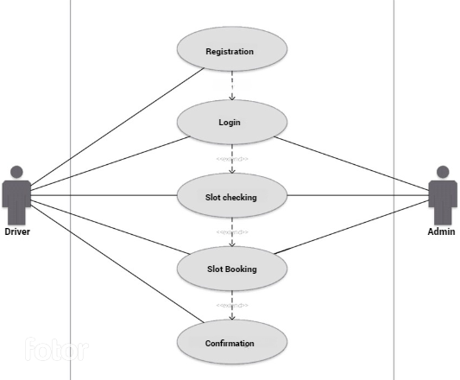
UML Diagrams 1. Use case diagram

Slide 8
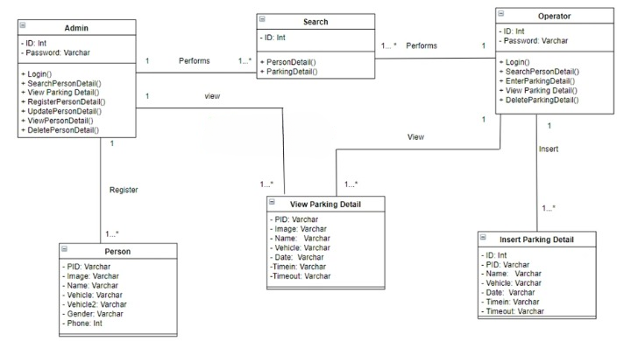
2. Class Diagram

Slide 9
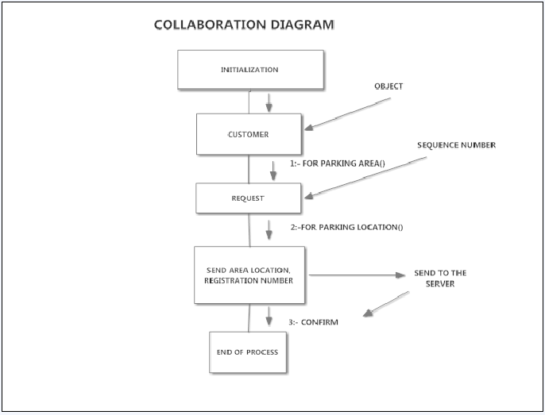
3. Collaboration Diagram

Slide 10
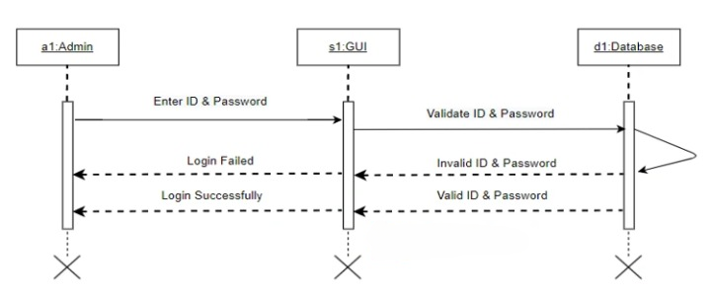
4. Sequence Diagram

Slide 11
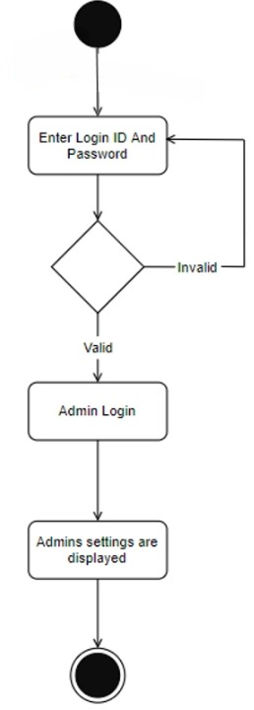
5. Activity Diagram

Slide 12
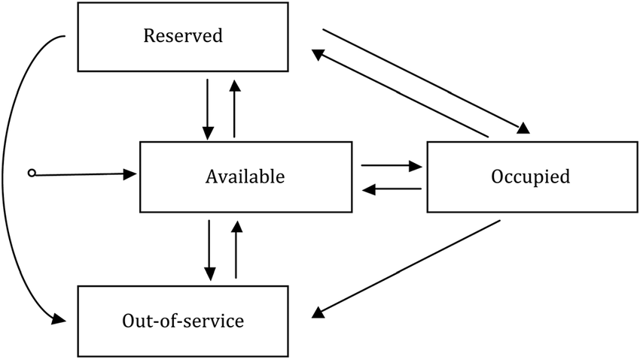
6. State Chart Diagram

Slide 13
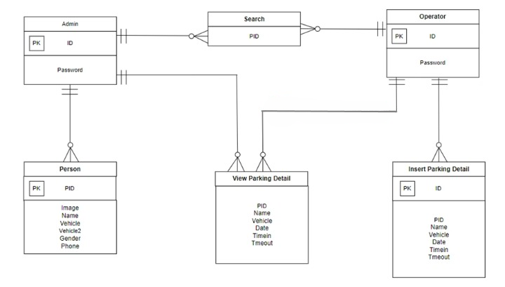
7. ER Diagram

Slide 14
Objectives
The objective of the Vehicle Parking Management System (VPMS) are the specific goals and purposes that the system aims to achieve. These objectives guide the development and implementation process, outlining the intended outcomes and benefits. The objectives of the Vehicle Parking Management System (VPMS) project are formulated to address the existing challenges in parking management systems and to provide a comprehensive solution that enhances efficiency, security, and user experience.
Following are the major objectives behind:
Optimize Space Utilization
Automate Entry and Exit Processes
Real-time Monitoring and reporting
Enhance Security Measures
User-friendly Interface
Integration with Modern Technologies

Slide 15
System Design & Implementation
SYSTEM DESIGN: is done and handled with the help of table creation. The system design for the Vehicle Parking Management System (VPMS) involves creating detailed plans for the structure and functionality of the system. This includes defining tables for data storage and outlining the overall architecture of the project.
The Source code is a Python Script that uses the PyQt5 library to create a graphical user Interface (GUI) application. It consists of several classes and functions that define the behavior of the application.
1. Table Details:
2. Implementation:
3. Source Code Overview

Slide 16
Implementation Flow: Initialization: The script initializes the necessary modules and classes. Window Display Functions: Functions to display setup and login windows are defined. Application Initialization: An instance of QApplication and window classes are created. Checking Configuration: The script checks for the existence of a configuration file to determine the flow. Timer Execution: Depending on the existence of the configuration file, timers are set to display the appropriate window. Application Execution: The script enters the application's event loop and executes the application. This implementation flow provides a foundation for the VPMS, utilizing Python, PyQT for the GUI, and MySQL for efficient data storage. The design ensures a user-friendly interface and effective management of parking spaces and vehicle information.

Slide 17
Timeline of Project
The timeline of a project refers to the planned sequence of activities and events from the project's initiation to its completion. The timeline is typically depicted on a Gantt chart or in a project schedule. Here's a breakdown of the project timeline:
1. Initiation:
The project timeline begins with the initiation phase, where the project is defined at a broad level. Goals, objectives, and initial planning take place during this stage.
2. Planning:
Detailed planning follows the initiation, involving the creation of project plans, task lists, resource allocation, budgeting, and scheduling. The Gantt chart is a valuable tool during the planning phase to visualize the project schedule.
3. Execution:
The execution phase is where the actual work of the project is carried out. Tasks identified in the planning phase are executed, and resources are actively engaged.
4. Monitoring and Controlling:
Throughout the project, monitoring and controlling activities occur. Progress is tracked against the project schedule, and adjustments are made as necessary. Gantt charts aid in real-time monitoring of task completion.
5. Completion:
The project timeline concludes with the completion of all tasks and the achievement of project objectives. Final deliverables are produced, and the project is closed.

Slide 18
Timeline Duration Estimation
.
7
Time
Estimation
12/23/2023
7
6
12
/
8/2023
14
5
11/30/2023
7
Duration
4
11
/
8/2023
28
3
10/25/2023
14
2
ST
ART DATE
DURATUION
10
1
/
8/2023
7
10
/
8/2023
10/28/2023
11/17/2023
12
/
7/2023
12/27/2023
Start and End Dates

Slide 19
Gantt Chart of Duration
TASK | DURATION (Weeks) | START DATE | END DATE | DEPENDENCIES
Project Initiation | 1 | 08/10/2023 | 15/08/2023 | -
Requirement Analysis | 1 | 17/08/2023 | 24/10/2023 | Project Initiation
System Design (Database, User Interface (UI) & Integration) | 2 | 25/10/2023 | 07/11/2023 | Requirement Analysis
Development (Frontend & Backend) | 4 | 08/11/2023 | 29/11/2023 | System Design (All)
Database Implementation | 1 | 30/11/2023 | 07/12/2023 | Development (Backend)
Testing (Unit & Integration) + User Acceptance Testing | 2 | 08/12/2023 | 22/12/2023 | Testing (All)
Project Documentation & Closure | 1 | 23/12/2023 | 30/12/2023 | Monitoring and Maintenance Planning

Slide 20
Outcomes / Results Obtained
Efficient Space Utilization
Streamlined Entry and Exit Processes
Real-time Monitoring and Availability Updates
Enhanced User Experience
Robust Security Measures
Integration with Modern Technologies
Scalability and Flexibility
Compliance with Parking Regulations
User Training Programs
Continuous Monitoring and Maintenance

Slide 21
Conclusion
Overall Conclusion for VPMS Project:
The Vehicle Parking Management System (VPMS) project has been a comprehensive endeavor aimed at addressing the challenges associated with traditional parking management systems and enhancing the overall efficiency and user experience in parking facilities. The following key points encapsulate the overall conclusion of the project:
Achievement of Project Objectives
Enhanced User Experience
Optimized Space Utilization
Security and Compliance
Integration with Modern Technologies
Contributions to Parking Management Practices
Future Enhancements and Recommendations

Slide 22
References
Penttila, K., Keskilammi, M,. Sydanheimo, L., Kivikoski, M.,2006. Radio frequency technology for automated manufacturing and logistics control. International Journal OfAdvanced Manufacturing Technology, 31 (1-2): 116-124.
Zhang, L., 2005. An Improved Approach to Security and Privacy of RFID application System. Wireless Communications, Networking and Mobile Computing. International Conference. (2): 1195- 1198.
Higgins, N., L., Cairney, T., 2006., RFID opportunities and risks. Journal of Corporate Accounting & Finance, Vol, 17 (5):51-57.
Xiao, Y., Yu, S., Wu, K., Ni, Q., Janecek., C., Nordstad, J., 2006. Radio frequency identification: technologies, applications,and research issues. Wiley Journal of Wireless Communications and Mobile Computing. (accepted for publication).
Goodrum, P.,McLaren, M., Durfee, A.,2006. The application of active radio frequency identification technology for tool tracking on construction job sites. Automation in Construction, 15 (3): 292-302.
Waqas, M., Iftikhar, U., Safwan, M., Abidin, Z. U., & Saud, A. (2021). Smart vehicle parking management system using image processing. International Journal of Computer Science & Network Security, 21(8), 161-166.
Nawale, A., Gadhave, A., Ghose, S., & Khandagale, D. R. L. SMART PARKING SYSTEM.
Bayraktar, M. E., Arif, F., Ozen, H., & Tuxen, G. (2015). Smart parking-management system for commercial vehicle parking at public rest areas. Journal of Transportation Engineering, 141(5), 04014094.
Aalsalem, M. Y., Khan, W. Z., & Dhabbah, K. M. (2015, July). An automated vehicle parking monitoring and management system using ANPR cameras. In 2015 17th International Conference on Advanced Communication Technology (ICACT) (pp. 706-710). IEEE.

Slide 23
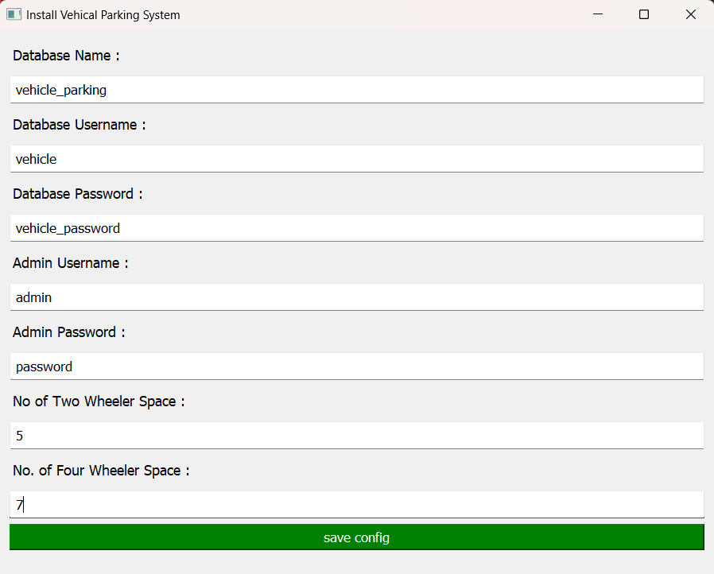
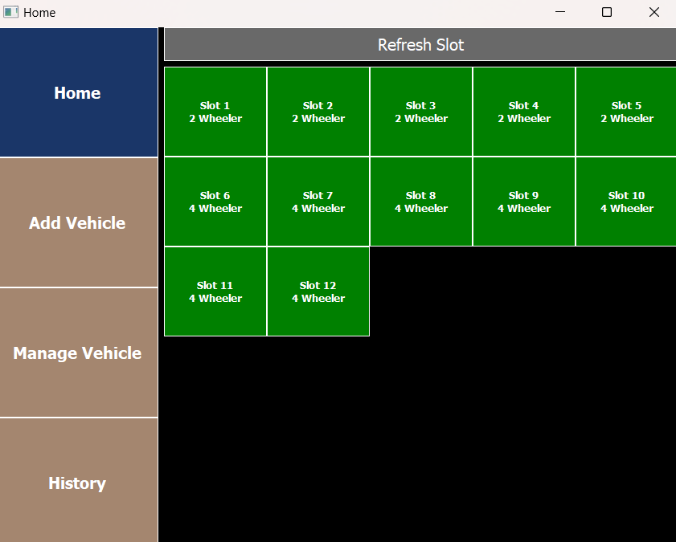
Outputs

Slide 24
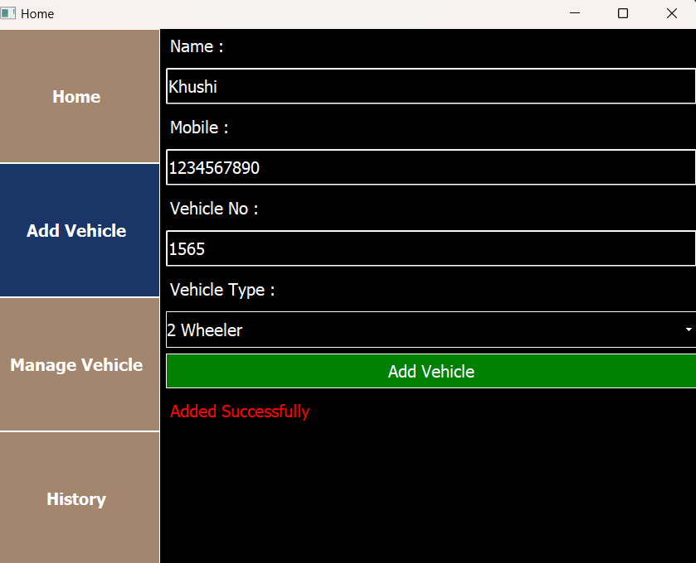
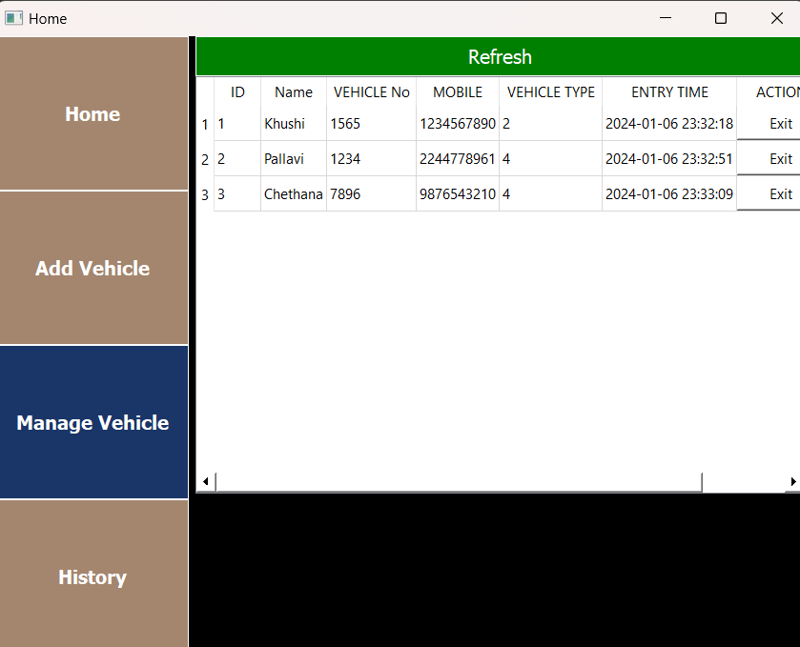
Outputs

Slide 25
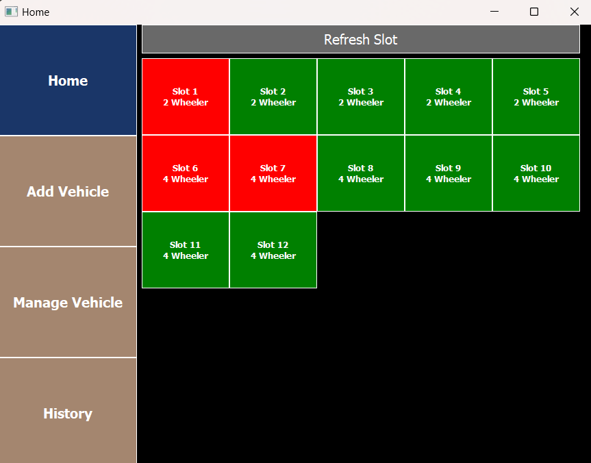
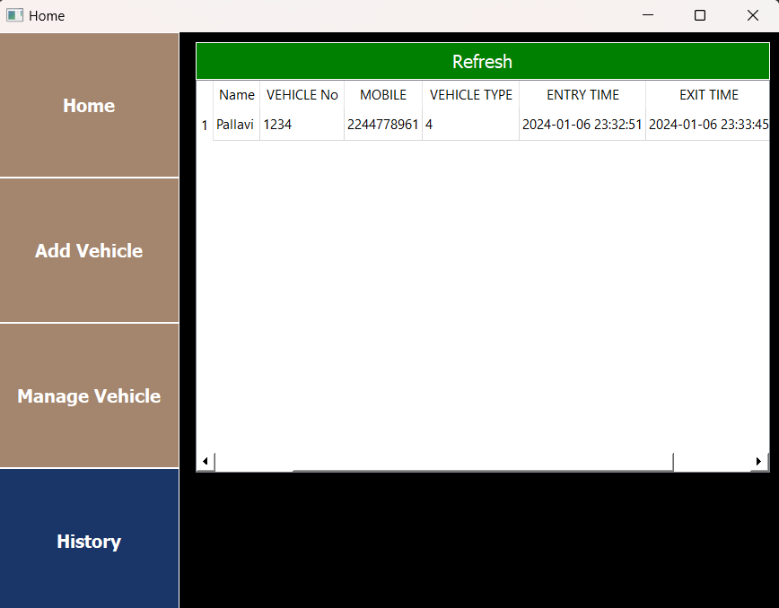
Outputs

Slide 26
Publication Details
Dear Pallavi H P, For Paper ID 1705337 Published paper link is
https://irejournals.com/paper-details/1705337
Thank You for Publishing with IRE Journals

Slide 27

Thank You

